Slide 1
KnowItAll Web App
——Iteration 1 Report
Daniel Makover
Kun Mo
Gunnar Nichols
Heli Kolambekar
Haoyi Zhu
Yuwei Wu
Weiye Xu

Slide 2
Features
Essential Features:
1 -Single player game
List of Questions, answers, and possible answers
Database table for questions
Ability to import questions into the database
Front End logic and UI for simple player game
Back End logic for single player game
2 -Leaderboard
Database table for leaderboard scores
Ability for a user to post their score to the leaderboard
Logic and UI to display leaderboard scores
Desirable Features:
In game Lifelines
50-50
Skip to next Question
Game Timer

Slide 3
DEMO

Slide 4
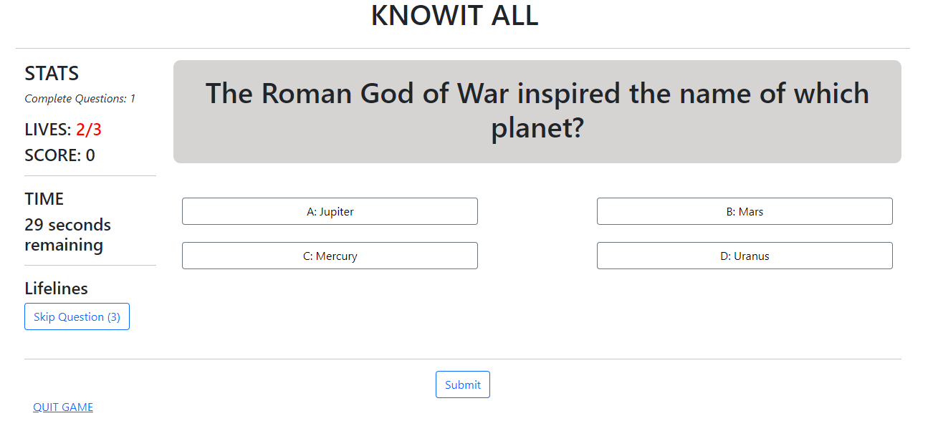
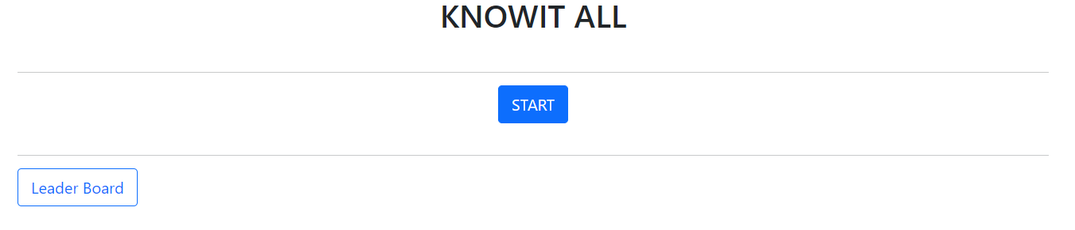
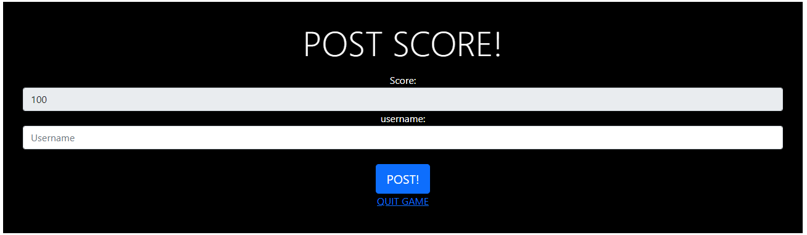
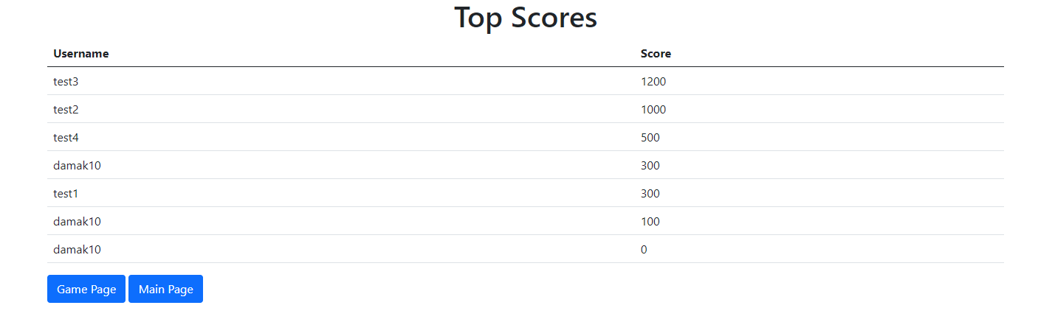
UI Design
game.html
main.html
post score form
Leaderboard.html

Slide 5
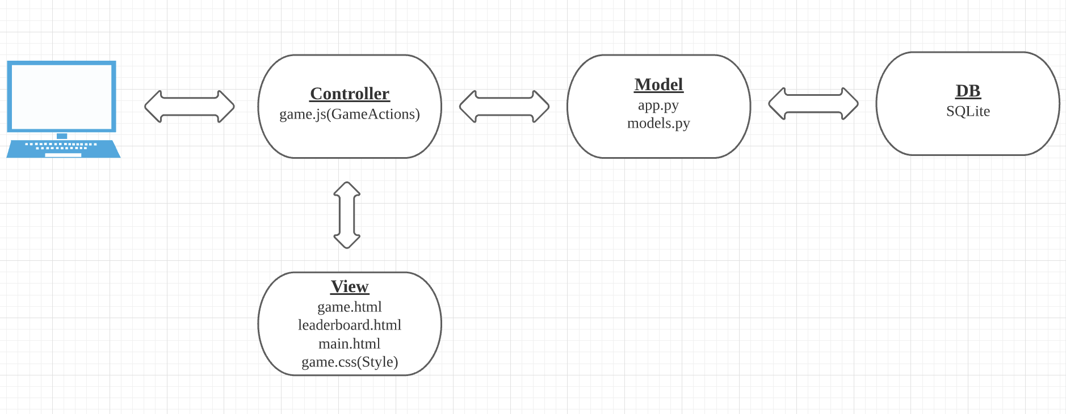
Architecture
Following Model View Controller Architecture
Flask - Framework
SQLite - DB
SQLAlchemy

Slide 6
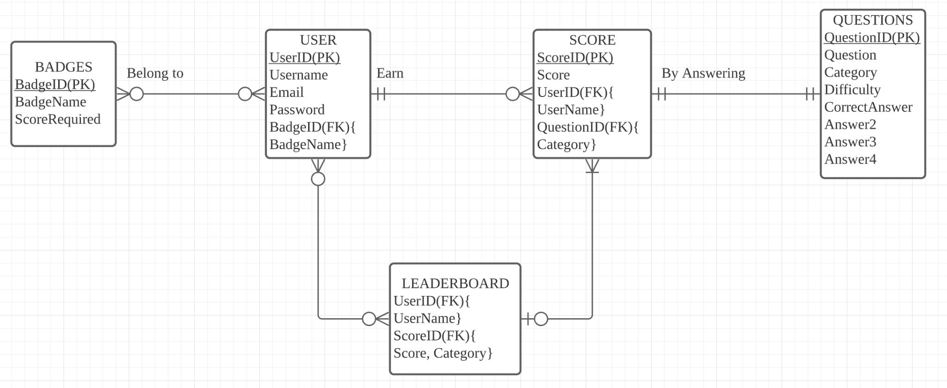
Database Design
DB design will continue to iterate
For iterration1:
Questions table
Score table

Slide 7
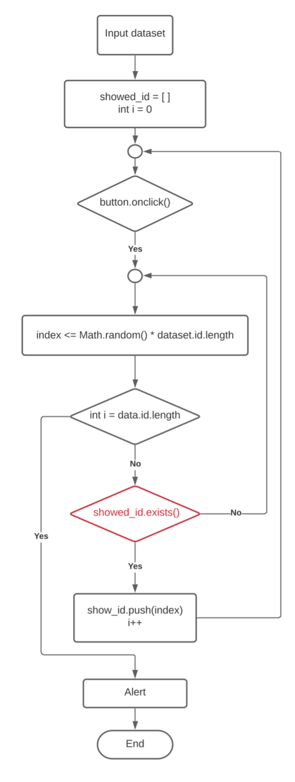
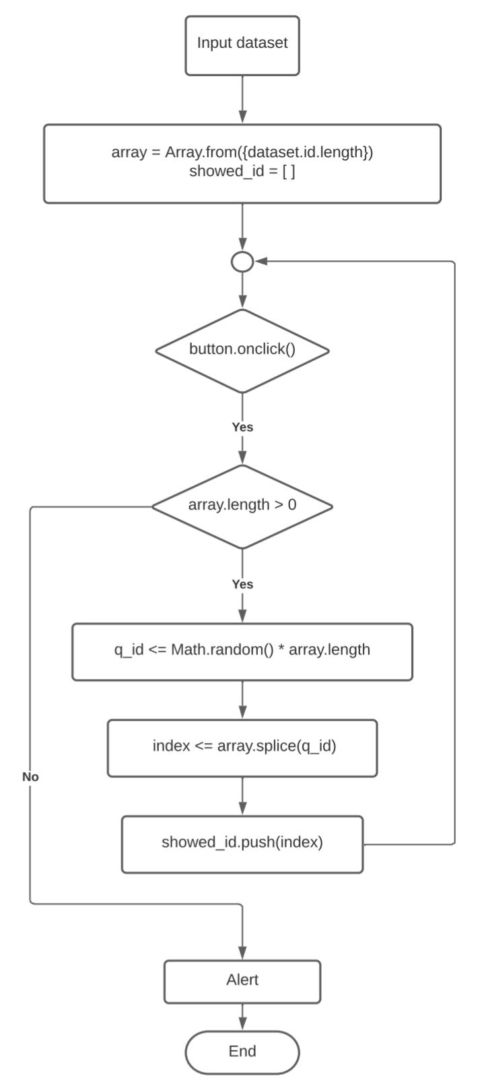
Key Algorithms
No duplicated questions
Advantage:
Easy to figure out and implement
Disadvantage:
Have more and more random id of question are “fail to be chosen” with the usage of id
Advantage:
Never fail to find and use the question id.
Disadvantage:
Splice method will change the original array
First version
Second version

Slide 8

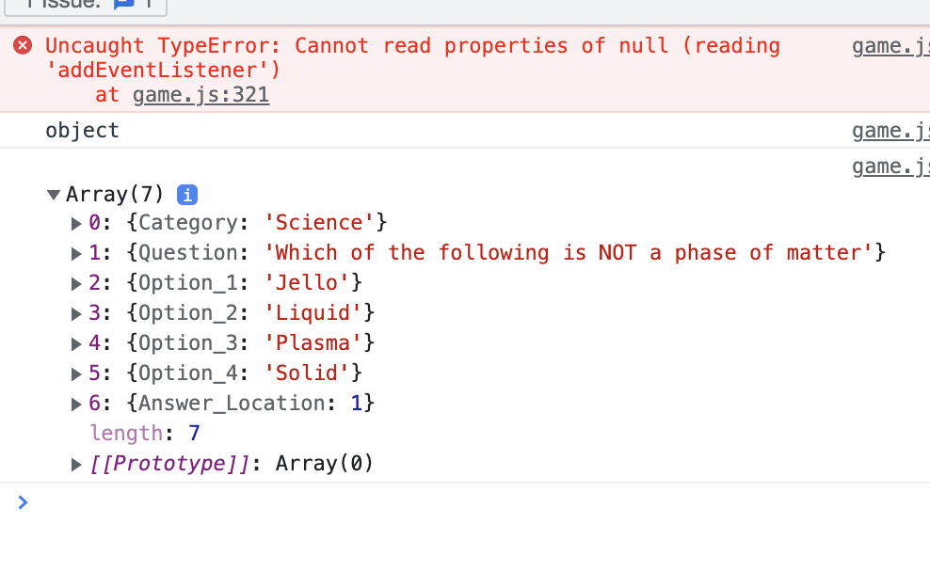

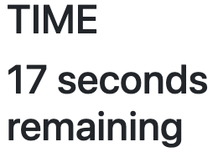
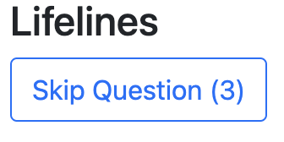
Current Security Concerns
Concerned Game Features:
Remaining lives
Score
Time countdown
Up limits
for skipping questions
Answer Location in Javascript

Slide 9
Security design & plan: next steps
Solutions to current concerns:
Next: For Player Profile Page
“Yeah, I want to post my score on the leaderboard and login to keep scores!”
For registered/login user:
Login methods:
username/id passwords
Other api
“Nah, I’m just poking around… Please don’t keep my scores.”
How to store the temporary player data in the backend
Frontend
Backend
Separate Javascripts
Player-end
Server-end

Slide 10
Iteration 2 Plans
Users
Players will be able to login as distinct users
Will support password reset and email verification
Game session restoring (time permitting)
Additional Lifelines
Add 50/50 lifeline
Add additional time for question lifeline
Testing
Establish Testing Scripts
Categories
Before initiating a game the player will have a chance to select a category
Each category has a distinct leaderboard
Profile Page (time permitting)
Players will be able to see their top scores and other user statistics
Players will be able to manage user options
Code Refactoring
Current code will be reorganized and streamlined

